Slide 1
PSYCHOLOGICAL DISORDER PROFILING {IMPLEMENTING SCIKIT-LEARN}
< RECENT TRENDS IN SOFTWARE ENGINEERING >
BY
ANIRUDH BHATTACHARYA
PRANAV NIMBALKAR
Notes:
Source: https://6lli539m39y3hpkelqsm3c2fg-wpengine.netdna-ssl.com/wp-content/uploads/2018/07/brain_shutterstock_747728734.jpg

Slide 2
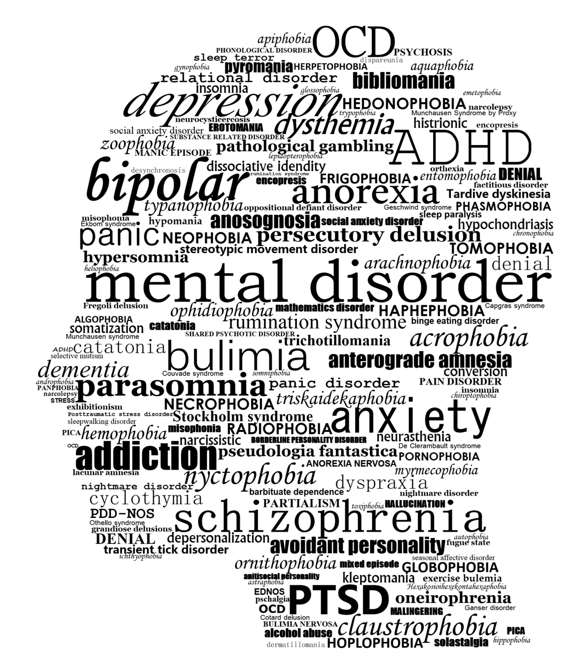
CONTENTS
CLEANING DATA
CATEGORIZING DATA
FEATURES – WORD FREQUENCY
LABELS – LABEL ENCODER
IMPLEMENTING ALGORITHMS & 5-FOLD DATA CROSS VALIDATION
Q&A
Notes:
ImageSource:https://upload.wikimedia.org/wikipedia/commons/thumb/2/2b/Mental_Disorder_Silhouette.png/1200px-Mental_Disorder_Silhouette.png

Slide 3
CLEANING DATA
REMOVING USER NAMES FROM TWEETS
REMOVING ENGLISH STOP WORDS
REMOVING IRRELEVANT WORDS
“RT” FROM RETWEETS
“USERNAME” OF THE PERSON WHOSE TWEET IS RETWEETED
REMOVING THE HASHTAGS FROM TRAINING DATA
“#DEPRESSION”, “#ANXIETY” & “#OCD”
REMOVING NOISE
LINKS TO TWITTER PAGES WITHIN DATA
3
Notes:
ImageSource:https://upload.wikimedia.org/wikipedia/commons/thumb/2/2b/Mental_Disorder_Silhouette.png/1200px-Mental_Disorder_Silhouette.png

Slide 4
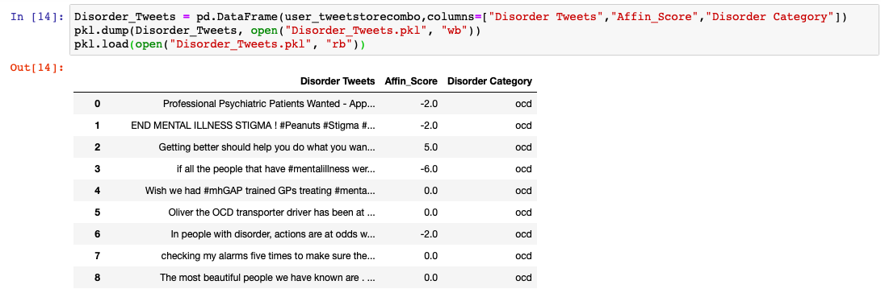
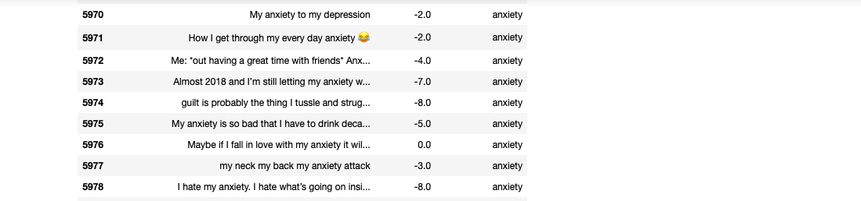
CATEGORIZING DATA
LOADING DATA INTO PANDA DATAFRAMES AS PER DISORDER CATEGORY
4
Notes:
ImageSource:https://upload.wikimedia.org/wikipedia/commons/thumb/2/2b/Mental_Disorder_Silhouette.png/1200px-Mental_Disorder_Silhouette.png

Slide 5
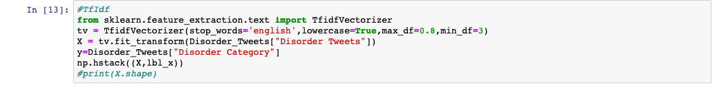
FEATURES – WORD FREQUENCY
FEATURES PROVIDE UNIQUE REPRESENTATION FOR SAMPLE DATA
WORD FREQUENCY
MOST COMMON FEATUE FOR TWEET ANALYSIS
TfidfVectorizer() METHOD FROM Scikit-Learn LIBRARY
TF-IDF FREQUENCY MEASURES IMPLEMENTED USING
max_df = 0.8 (WORDS OCCURRING IN MORE THAN 80% OF TWEETS)
min_df = 3 (WORDS OCCURRING IN LESS THAN 3 TWEETS)
Notes:
ImageSource:https://upload.wikimedia.org/wikipedia/commons/thumb/2/2b/Mental_Disorder_Silhouette.png/1200px-Mental_Disorder_Silhouette.png

Slide 6
LABELS – LABEL ENCODER
LABELS ARE USED TO ASSIGN SAMPLES TO DIFFERENT CLASSES
7
Notes:
ImageSource:https://upload.wikimedia.org/wikipedia/commons/thumb/2/2b/Mental_Disorder_Silhouette.png/1200px-Mental_Disorder_Silhouette.png

Slide 7
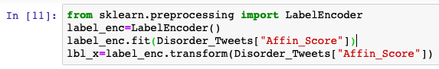
LABELS – LABEL ENCODER
Afinn WORDLIST IS USED TO SCORE THE SENTIMENT OF THE SENTENCES
POSITIVITY, NEGATIVITY, NEUTRALITY
LabelEncoder() METHOD OF Scikit-Learn LIBRARY
CONVERTS CATEGORICAL AFINN SCORE INTO NUMERICAL FEATURE
Notes:
ImageSource:https://upload.wikimedia.org/wikipedia/commons/thumb/2/2b/Mental_Disorder_Silhouette.png/1200px-Mental_Disorder_Silhouette.png

Slide 8
IMPLEMENTING ALGORTIHMS &
5-FOLD DATA CROSS VALIDATION
Notes:
ImageSource:https://upload.wikimedia.org/wikipedia/commons/thumb/2/2b/Mental_Disorder_Silhouette.png/1200px-Mental_Disorder_Silhouette.png

Slide 9

Notes:
ImageSource: http://www.klimatupplysningen.se/wp-content/uploads/2015/04/question-marks-picture.jpg

Slide 10

Notes:
ImageSource: http://idrd-bham.info/idrd/wp-content/uploads/2015/04/thank-you-note-ftr.jpg

